Slide 1


Scale your data warehouse environment
SQL Server 2012 Fast Track Data Warehouse Reference Architectures from HP and Microsoft
Notes:
What does it take to get on the fast-track to a scalable data warehouse environment?
It takes deploying a SQL Server 2012 Fast Track Data Warehouse Reference Architecture from HP and Microsoft.
Lets see how.

Slide 2

Agenda
HP and Microsoft Data Management Solutions Portfolio
HP and Microsoft solution – SQL Server 2012 Fast Track Data Warehouse Reference Architectures
Successful deployments
Getting started
Notes:
Before we begin our presentation today, let’s review the topics we’ll discuss:
Identifying today’s top data management challenges
Exploring the HP and Microsoft solution to these challenges, namely the SQL Server Fast Track Data Warehouse Reference Architectures from HP
Features and benefits
Services and support
Added value of HP Converged Infrastructure
Reviewing some successful deployments
Talking about what you can do next to get started with your data center transformation, using SQL Server 2012 Fast Track Data Warehouse Reference Architectures for HP.

Slide 3



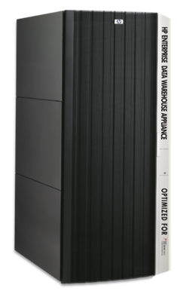
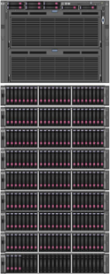








HP and Microsoft Data Management Solutions Portfolio
Operational Data
Data Management and Storage
HP Database Consolidation Reference Architecture (RA) (scale out)
Private Cloud for high I/O workloads
Consolidation toolkit
Features dynamic provisioning, chargeback, and integrated management
HP Universal Database Solution for Mission-Critical x86 Reference Architecture (RA) – SQL Server (scale up)
High performance OLTP solution
300% greater sustained IOPS
10x faster time to production
HP AppSystem for Microsoft SQL Server 2012 Parallel Data Warehouse Version 2 (scale out)
High performance data warehouse architecture (MPP)
50% the acquisition cost
33% 3 yr TCO
Scalable to over 600TB
SQL Server Fast Track Data Warehouse Reference Architecture (RA) Version 3 (scale up)
Cost efficient architecture (SMP)
10 - 100X performance improvement
Scalable up to 60TB
* An Alinean Management White Paper – August 2012
Notes:
Note to speaker: This slide is a representation of the current solutions portfolio. On March 25, 2013, HP plans to introduce a replacement for the HP Enterprise Data Warehouse Appliance represented on this slide. The replacement product will be the HP AppSystem for Microsoft SQL Server 2012 Parallel Data Warehouse Version 2. If your customer is under NDA, the next slide in this presentation represents the portfolio with the follow-on product (the HP AppSystem) called out in place of the HP Enterprise Data Warehouse Appliance. In addition, if your customer would like to learn more about the upcoming AppSystem, there is an NDA-only presentation available at www.winthedatacenter.com.
Building on deep experience building solutions with HP hardware and software infrastructure plus Microsoft SQL Server 2012, HP and Microsoft have recently expanded our Data Management offerings to include HP AppSystems based on HP Converged Infrastructure solutions for critical phases of the data management lifecycle, specifically to support transaction processing and data warehousing workloads. Our portfolio includes both scale-out and scale-up offerings, including both Reference Architecture-based and fully integrated Appliance products and services.
Regardless of their form factor, each of these HP AppSystems solutions share a handful of key attributes. Each are complete solutions, with end-to-end specifications for hardware, software, and networking either defined or pre-integrated into the product, taking the guesswork out of the selecting the right components and basic configurations for your workload. Further, they are optimized for the individual requirements of each workload; each solution is right-sized and purpose built for the intended workload(s), focusing specifically on the appropriate combination of technologies required to support the intended usage scenarios. Finally, they create agility. Pre-integration and definition creates faster, lower risk deployment. Use of industry standard components and management platforms decreases time for adoption. Integration with existing analysis and reporting tools, provides flexibility.
Focusing on the individual solutions themselves, I’d like to provide a brief overview of each offering.
HP Database Consolidation Reference Architecture. This is a Reference Architecture based solution, designed to deliver cost savings and efficiency through database and application virtualization, as well as flexibility and agility through creation of a SQL Server-based Private Cloud. It’s been specifically sized for high I/O transaction processing workloads typified by Microsoft SQL Server, and includes integration with Microsoft’s MAP tool which delivers consolidation recommendations specifically suited to a system based on the Reference Architecture. For full Private Cloud enablement and management, it relies on Microsoft System Center and HP Insight Control.
HP Universal Database Solution for Mission Critical x86 Reference Architecture. This is as well a Reference Architecture-based solution designed for the most demanding OLTP workloads. This converged system leverages advanced features of the HP ProLiant DL980, flash-based VMA-series memory arrays, and SQL Server 2012, specifically advances in high availability and disaster tolerance. Compared to alternative offerings from companies like Oracle with their Exadata X2-8 product, this solution provides approximately 300% greater sustained IOPS to handle high volumes of data and a 10x faster time to production, all at over 50% less cost.
Data Warehousing. Our Data Warehousing portfolio provides a wide range of options on several dimensions including capacity, architecture, performance and cost.
HP Enterprise Data Warehouse Appliance Optimized for Parallel Data Warehouse 2008 R2 (EDW). The HP EDW Appliance is a true appliance solution based on an optimized, MPP architecture. It ships fully assembled and ready for installation and deployment at your organization’s location. Designed specifically for high performance and availability, the appliance runs approximately 50% of the acquisition cost of a comparable Oracle Exadata solution and the three year TCO is roughly 1/3 of that solution over 3 years. With massive scalability, it supports environments that require up to 610TB of capacity.
Note to speaker: A new version of the HP Enterprise Data Warehouse Appliance is scheduled for introduction in March, 2013. It will be called the HP AppSystem for Microsoft SQL Server 2012 Parallel Data Warehouse (PDW) v2. It is based on a revised architecture, designed specifically to take advantage of improvements in the Microsoft PDW software. There is a customer presentation on the new product which can be delivered under Non-Disclosure with customers until time of public announcement. The NDA presentation can be found at: www.winthedatacenter.com.
SQL Server Fast Track Data Warehouse Reference Architecture. The Fast Track Data Warehousing reference architectures comprise a wide portfolio of cost effective, SMP-based solutions that provide scalability up to 60TB and come in 5 distinct configurations to meet your price/performance requirements. Based on Microsoft Fast Track Data Warehousing specifications, SQL 2012 improvements deliver up to 100x performance improvement in query performance and measured throughput compared to SQL Server 2008R2 Fast Track Data Warehouse systems (100x improvement via xVelocity in-memory technologies for star joins and similar query types). Source: http://social.technet.microsoft.com/wiki/contents/articles/4995.sql-server-columnstore-performance-tuning.aspx
<<Next Slide>>

Slide 4



SQL Server Data Warehousing options
Software:
Customers acquire and tune the software to their own hardware without guidance
Reference architectures:
Deliver hardware and software containing pre-tested configuration with best practices (optionally pre-built)
Appliances:
Deliver a solution with hardware and software already integrated, tested, tuned, and configured
Effort to build
Variable to High
Effort to build
Low – Mid
Effort to build
Low
Tuning
Mid
Tuning
Low
Tuning
Low
Flexibility in configuration
High
Flexibility in configuration
Mid
Flexibility in configuration
Low
Offerings
SQL Server 2008 R2
SQL Server 2012
Offerings
Fast Track for SQL Server 2012
Fast Track for SQL Server 2008 R2
Offerings
HP Enterprise Data Warehouse
Notes:
Note to presenter:
HP offers a range of Data Warehouse solutions from fully customizable through an appliance offering. Each of these options offer benefits for customers, including the effort involved for the customer to build, the tuning that has gone into the design and the flexibility to make changes to the configuration.

Slide 5

SQL Server 2012 Fast Track Data Warehouse Reference Architectures
The most efficient and consistent way to streamline SQL Server data warehouse solution deployments on the industry’s pre-eminent, preconfigured Converged Infrastructure — with the most extensive, factory-based integration and long-term support by the world’s most experienced Microsoft partner.
Notes:
The solution is to deploy a SQL Server 2012 Fast Track Data Warehouse Reference Architecture, delivered by HP and Microsoft. This model uses an I/O balanced approach to implementing a symmetric multiprocessor (SMP)-based SQL Server data warehouse with proven performance and scalability expectations for data warehouse workloads. The goal of a Fast Track Data Warehouse reference configuration is to achieve a cost-effective balance between SQL Server data processing capabilities and realized component hardware throughput.

Slide 6


SQL Server Fast Track program components
A workload-specific database system design and validation program
Software
SQL Server 2012
Windows Server 2008 R2
Database configuration
Workload specific
Database architecture
SQL Server settings
Windows Server settings
Performance guidance
Processors
Networking
Servers
Hardware system design
Tight specifications for servers, storage, and networking
Resource balanced and validated
Latest generation servers and storage
Storage
Notes:
Fast Track Data Warehouse from HP and Microsoft are scalable, pre-tested, cost-effective reference architectures that remove the unknowns from hardware selection and configuration for SQL Server data warehouse solutions. The new reference architectures provide server and storage guidance for various data warehouse workloads—giving you the most efficient hardware for your solution, saving you time and cost in choosing the right technology for your business needs. The HP reference configurations bring together the right mix of technology and software, integrating the powerful HP ProLiant server line – including the latest ProLiant Gen8 servers – the robust HP MSA storage array, and the scalable data warehouse capabilities of SQL Server 2012.
Goal of the component architecture
Balance between I/O and Processing capability
Cost management
Know the capability of what you are buying. Helps manage scaling and long term costs
Buy in the right ratios. Don’t overspend for CPU or Disk you can’t utilize.
The CPU is balanced for maximum consumption rate of cached data for targeted query mix
The Controller (service processor) is balanced for bandwidth needed to feed CPU cores (based on targeted query mix)
The HBA is balanced for an aggregate bandwidth array controllers
The switches are balanced and aligned with HBA bandwidth and optimized for sequential I/O
The disks are balanced for aggregate bandwidth of array controllers/database capacity

Slide 7
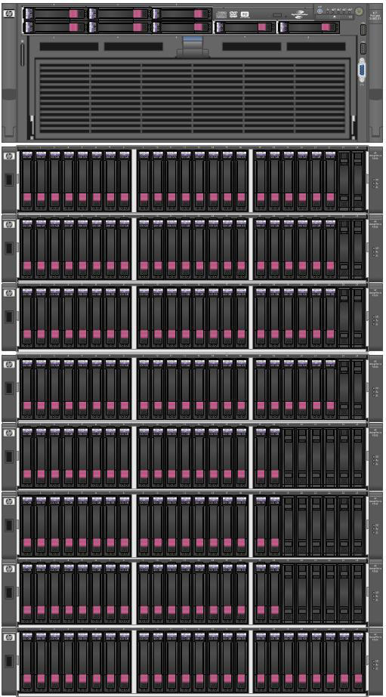
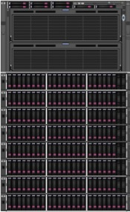
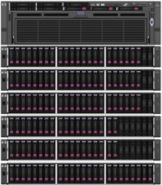
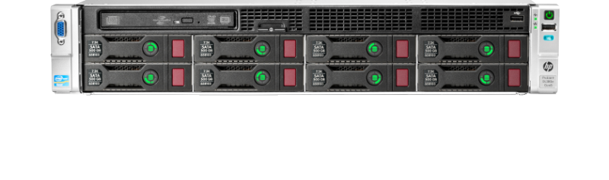
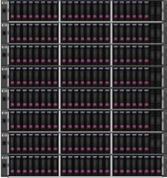
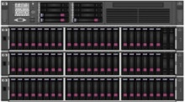

Microsoft SQL Server 2008 R2
Fast Track Data Warehouse reference architectures
Architectures refreshed with HP’s new CPUs/generations
Sizing based on “rated” capacity, not maximum capacity
Entry level offering ProLiant DL370 (2 P) Internal disks (4.5 -6 TB) Expansion (10-16 TB) | Basic offerings ProLiant DL380 Gen8 and DL385 G7 (2 P) MSA P2000 (10-20 TB) | Mainstream offerings ProLiant DL585 G7 (4 P) ProLiant DL580 G7 (4 P) MSA P2000 (20-40 TB) MSAP2000 (60 TB) | Premium offering ProLiant DL980 (8 P) MSA P2000 (95 TB)
Notes:
Even though SQL Server 2012 is the latest and greatest release, HP and Microsoft still support SQL Server Fast Track Data Warehouse Reference Architectures built on the SQL Server 2008 R2 release.
You can choose from seven tested Reference Architectures, shown here in a continuum from small to large. You can start at any point along the continuum that makes the most sense for your organization, and then move up as needs escalate and budget allow.
These solutions leverage the flexibility and scalability of ProLiant Gen8 and G7 servers, as well as HP P2000 MSA G3 Storage.

Slide 8
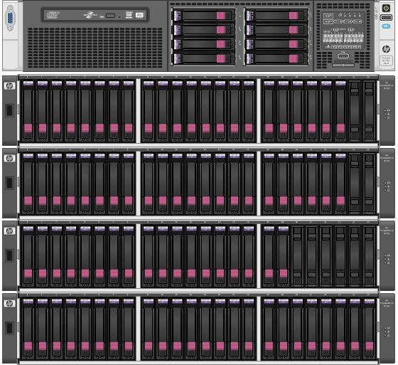
Microsoft SQL Server 2012
Fast Track Data Warehouse reference architectures
Basic SMP: two-socket processor configuration
HP DL380 Gen8 Server with HP P2000 G3 MSA
E5-2690 Sandybridge CPUs (16 cores), 192 (rec) — 768 GB RAM
30 TB Fast Track Data Warehouse User Rated Capacity
Mainstream SMP: four-socket processor configuration
HP DL580 G7 Server with HP P2000 G3 MSA
E7-4870 CPUs (40 cores), 256 GB (rec) — 2 TB RAM
60 TB Fast Track Data Warehouse User Rated Capacity
Accelerate deployment and optimize results
Balanced hardware approach ideal for data marts
Storage: HP P2000 G3
Notes:
HP and Microsoft help you create and scale your data warehouse solution fast. With Fast Track Solutions, you can deploy a SQL Server 2012 data warehouses in half the time, thanks to:
Predictable “out of the box” solutions designed with best practices for data layout, loading and management
Designed optimally for sequential data workloads
Factory integration with implementation services available
Reference Architectures include:
DL380 Gen8
E5-2690 Sandybridge CPUs (16 Cores)
30TB Fast Track Data Warehouse User Rated Capacity
DL580 G7
E7-4870 CPUs (40 Cores)
60TB Fast Track Data Warehouse User Rated Capacity

Slide 9
Consistent performance
Capacity linked to throughput
Min rate MBs | Max rate MBs | FTDW target capacity TB | Capacity category ratio
10500 | 20000 | 80 | 100%
9200 | 10499 | 70 | 88%
7900 | 9199 | 60 | 86%
6600 | 7899 | 50 | 83%
5300 | 6599 | 40 | 80%
4000 | 5299 | 30 | 75%
2700 | 3999 | 20 | 67%
1500 | 2699 | 10 | 50%
1000 | 1499 | 5 | 50%
600 | 999 | 2 | 40%
Published database storage capacity figures must guarantee a minimum I/O throughput to pass validation
Throughput is based on empirical data from Fast Track Data Warehouse validated systems
Ensuring that customers can make accurate comparisons between partner systems
Two socket 12-20 core Intel @ 300+ MCR
Four socket 32-40 core Intel @ 300+ MCR
Notes:
Emphasize importance of the relationship between I/O Throughput (horsepower) and Capacity. I.E. You can’t add capacity to a truck w/o adding Horsepower and appropriate infrastructure like improved suspension (truck suspension/chassis is like the HBA and storage network infrastructure).

Slide 10
Performance improvements
With HP ProLiant Gen8 Servers and HP MSA P2000 G3 Array
 | DL380 G7/P2000 MSA G3 | DL380 Gen8/P2000 MSA G3 | % increase
Maximum user data capacity | 32 | 49 | 53%
Fast Track Data Warehouse recommended database capacity (TB) (3.5x compression) | 19 | 30 | 66%
Benchmark Scan Rate (BSR) – Logical | 2846 | 4606 | 62%
Benchmark Scan Rate (BSR) – Physical | 1971 | 3392 | 72%
Fast Track Data Warehouse average rated I/O (MB/s) | 2408.5 | 4000 | 66%
Fast Track Data Warehouse peak I/O (MB/s) | 3750 | 6045 | 61%
Notes:
If we look at the improvements based on our new DL380 Gen8 architecture, we can see the results of a faster CPU, which has additional cores. Additionally, we were able to add more storage arrays (e.g. more disks) and an additional HBA. Overall the architecture remained balanced, and let to impressive percentage increases.
Just from a historical perspective, when the SQL Server Fast Track Data Warehouse program began, with our first DL380G6 Reference Architecture it was rated at 4TB and throughput and slightly under 2GB/sec. In 3 years and 2 server generations, we have increased capacity by 750% and performance by over 100%.

Slide 11




End-to-end support for SQL Server 2012
Fast, effortless migration, installation, and deployment
Complete lifecycle solution services to accelerate time to business results
Strategy services
Design and transition
Start services
HP support
Application transformation and hosting options
Flexible leasing and financing to accelerate business priorities
Notes:
HP Technology Services consultants are fully trained on SQL Server 2012 and ready to handle your migration and installation needs – extending HP Services’ long history of providing superior support to the SQL Server marketplace.
In addition our services can help solve issues around your MSFT SQL Environment that include:
Information Strategy, Planning, and Governance
Disaster Recovery and Business Continuity
Modernization for SAP and Microsoft
Analytics Monitoring, Performance Tuning
Mixed Workload Review & Implementation
Information Synthesis and Delivery
HP Support services are ready for SQL Server 2012, giving customers one point of contact for hardware and software support.

Slide 12


Successful deployments
© Copyright 2012 Hewlett-Packard Development Company, L.P. The information contained herein is subject to change without notice.
12
Notes:
Next, let’s take a quick look at what some satisfied customers have to say about their Fast Track deployments.

Slide 13

Capital & Coast District Health Board
Located in Wellington, New Zealand, Capital & Coast District Health Board is responsible for assessing the health needs of the district’s population and contracting the most appropriate services to meet those needs, in addition to providing secondary services via hospital and community outreach programs.
Business need
HP solution
Client outcome
Provide a central repository for business intelligence solution that uses consistent, reliable design and automation to deliver advanced analytics rapidly
Consolidate data warehouse solution to provide a single data repository and reporting platform for all clinical and business information that is structured to support analysis across clinical and business information
Created standards for BI analysis and reporting to ensure faster access to data, which helps drive better patient care
Reduced costs more than 50% versus previous solution
Improved performance of data warehouse and BI systems by 50%
Notes:
About Capital & Coast District Health Board
Located in Wellington, New Zealand, Capital & Coast District Health Board is responsible for assessing the health needs of the district’s population and contracting the most appropriate services to meet those needs, in addition to providing secondary services via the hospital and community outreach programs.
Approach
Consolidate data warehouse solution to provide a single data repository and reporting platform for all clinical and business information that is structured to support analysis across clinical and business information
Solutions
Hardware:
HP Business Decision Appliance Optimized for SQL Server 2008 R2 and SharePoint Server 2010
Microsoft SQL Server Fast Track Data Warehouse Reference Architecture
HP ProLiant DL380 Server
HP Storage P2000 Modular Smart Array
HP Networking 2510G-24 Switch
Software:
HP iLO 3 Management
Microsoft SQL Server 2008 R2
Microsoft SQL Server Integration Services
Microsoft SQL Server 2008 R2 Reporting Services
Microsoft SQL Server 2008 R2 Analysis Services
Microsoft SharePoint Server 2010
Operating System:
Microsoft Windows Server 2008 R2
Network Protocol:
TCP/IP
HP Services:
HP Technical Support
HP Deployment
Results
Created standards for BI analysis and reporting to ensure faster access to data
Standalone BI environment provides more control and is easier to manage
Improve performance of data warehouse and BI systems by 50%
Save 2 months managing solution by implementing reference architectures
Reduce number of licenses required by 50% by consolidating on one platform
Important business intelligence data readily available from one source
Reduced costs more than 50% versus previous solution
Increased confidence in data helps to drive better patient care

Slide 14



SQL Server Fast Track customer momentum
“SQL Server Fast Track Data Warehouse literally took years off the development time for the project. They showed us how we could build our own business intelligence solution using a particular topology to meet our business requirements.”
—Fariba Anderson, Vice President of Lottery IT
“From an ROI perspective, the project more than paid for itself very early. We gained a lot of functionality at a lower cost than if we had gone with a new vendor.”
—Carla Rolinc, Vice President of Applications, Safety-Kleen
“Our IBM DB2 solution was very expensive in terms of hardware and software licensing costs. We just added 13 terabytes of capacity to our SQL Server Fast Track Data Warehouse at a minimal cost, and we can also add memory for much less money than we could with our previous solution.”
—Rajesh Babu, Senior Director Global BI, Universal Music Group
Notes:
OLG:
HP case study: http://h20195.www2.hp.com/v2/GetPDF.aspx/4AA3-7468ENW.pdf
Microsoft case study: http://www.microsoft.com/casestudies/Microsoft-SQL-Server-2008-R2-Enterprise/Ontario-Lottery-and-Gaming-Corporation/Lottery-Agency-Saves-Millions-and-Years-of-Work-with-Innovative-BI-Solution/4000011079
SafetyKleen:
HP case study: http://h20195.www2.hp.com/V2/GetPDF.aspx/4AA3-5709ENW.pdf
Microsoft case study: http://www.microsoft.com/casestudies/Microsoft-SQL-Server-2008-R2-Enterprise/Safety-Kleen/Environmental-Services-Firm-Transforms-Data-Analysis-and-Reporting-and-Saves-500-000/4000010349
Universal Music Group:
HP case study: http://h20195.www2.hp.com/V2/GetPDF.aspx/4AA3-9422ENW.pdf
Microsoft case study: http://www.microsoft.com/casestudies/Microsoft-SQL-Server-2008-Enterprise/Universal-Music-Group/Music-Provider-Moves-Warehouse-from-IBM-to-Microsoft-and-Cuts-Costs-by-97-Percent/4000011769

Slide 15



Business Benefits
Customers say it best
5x capacity
“For the cost and performance benefits we’ve experienced with the Fast Track solution, and for the ease with which we could scale the solution for the global environment, it was not a difficult decision to use this solution in other areas of the business.”
Rob Cromar, VP, Enterprise Reporting Systems, UMG
14x faster time-to-value
“The HP and Microsoft data warehousing solution will improve performance of the entire data warehouse environment and facilitate new opportunities in analytics.”
Christian Terhart, Senior Business Intelligence Architect, 1&1 Internet AG
5 to 10 times less effort
“The tightly integrated Fast Track data warehousing solution delivered by market leaders, HP, Microsoft, and Slalom, allowed us to consolidate a series of independent tool sets, reduce overhead, and provide a more reliable, single version of the truth with 5 to 10 times less effort.”
Mark Stone, Senior Vice President and CIO, Safety-Kleen
Notes:
Summing it all up, as we’ve looked at Converged Systems and Services available from HP for Data Management, the value of complete, optimized and agile systems becomes clear. But you don’t have to take my word for it. Here are some selected quotes from HP and Microsoft Data Management customers from around the world. You can see that these customers are experiencing many of the same outcomes as those that we’ve talked about so far today.
Universal Music Group, a FastTrack Data Warehousing customer, is realizing price/performance and scalability benefits from their system and are planning to expand to other areas of their business.
HP case study: http://h20195.www2.hp.com/V2/GetPDF.aspx/4AA3-9422ENW.pdf
Microsoft case study:http://www.microsoft.com/casestudies/Microsoft-SQL-Server-2008-Enterprise/Universal-Music-Group/Music-Provider-Moves-Warehouse-from-IBM-to-Microsoft-and-Cuts-Costs-by-97-Percent/4000011769
1&1 Internet in Germany, also a Fast Track customer, has seen dramatic improvement in time-to-value and see opportunities to drive more insightful analytics to further improve their competitive position.
HP Case study: http://h20195.www2.hp.com/V2/GetPDF.aspx/4AA3-9822ENW.pdf.
Microsoft case study: http://www.microsoft.com/casestudies/Microsoft-SQL-Server-2008-R2-Enterprise/11-Internet-AG/Internet-Services-Firm-Boosts-BI-Performance-by-30-Percent-with-Data-Warehouse-Solution/4000011821
Safety-Kleen, a US-based company, is the leader in developing innovative equipment for specialized cleaning needs. Using HP Fast Track Data Warehousing AppSystems, they are seeing dramatic improvements in efficiency in the delivery of useful, reliable business information to the business.
HP case study: http://h20195.www2.hp.com/v2/GetPDF.aspx/4AA3-5709ENW.pdf
<<Next Slide>>

Slide 16

Getting started
© Copyright 2012 Hewlett-Packard Development Company, L.P. The information contained herein is subject to change without notice.
16
Notes:
Now that you know what the solution is, let’s talk about how you get started with deployment.

Slide 17
Sample SQL Server Fast Track Reference Architecture
Bill of materials
Quantity | Part number | Description
 |  | Server configuration
1 | AM426A | HP ProLiant DL9 80 G7 Server CTO Chassis
1 | 597871-L21 | Intel Xeon X7 560 4P kit
1 | 597871-B21 | Intel Xeon X7 560 4P kit
1 | AM442A | DL9 80 CPU Assembly
4 | 578322-B21 | HP 1200W 12V HE AC Power Supply
1 | 534562-B21 | 1G FBWC Module
1 | 588137-B21 | DL9 80 G7 PCI-E Expansion kit
3 | 512545-B21 | HP 7 2GB 6G SAS 15K SFF DP ENT HDD
9 | AJ763A | HP 82E 8Gb Dual Port PCI-E FC HBA
8 | 588141-B21 | DL9 80 G7 Memory Board
64 | 500662-B21 | 8 GB Dual Rank x4 PC3-10600R Dimm
Notes:
We have included in a detailed Bill of Material in the HP whitepapers, providing customers the exact configuration details that we utilized in our testing.

Slide 18
HP Sizer for SQL Server Fast Track Data Warehouse
Helps determine optimal server configurations for current and future sequential data workload requirements
Aids in performance and capacity planning for storage subsystem
Helps maximize server utilization or leverage specific elements in existing infrastructure
Quantity | Part Number | Description
four | 585335-001 | HP DL385 G7 6136, eight core, 8 GB (1 P)
four | 585326-B21 | AMD Opteron 6136 2.4GHz 12 M 80 W FIO
two | 573087-001 | HP DL385 G7 6174, 12 core, 16 GB (2 P)
four | 604500-B21 | HP 4 GB 1 Rx4 PC3-10600R-9 Kit
six | AJ764A | HP SW 82Q PCle FC HBA
one | AJ797A | HP 2324 fc DC Modular Smart Array
72 | 418367-B21 | HP 146GB 3G SAS 10 K 2.5in DP ENT HDD
Notes:
The first stop is to visit the HP ActiveAnswers site to determine the best configuration for your organization. You can do that quickly and easily with the HP Sizer for SQL Server Fast Track Data Warehouse.

Slide 19
Simple Fast Track sizing
Formalizes SQL sizing process
Embeds decades of HP best practices
Provides extensive options for experts, yet easy for a novice
Includes built-in defaults, what ifs, and detailed, customizable configurations with bill of materials
Downloads totally free
Underlines HP commitment to customer success
Business needs
HP Sizer for HP Fast Track data warehouse
Optimal Fast Track Data warehouse solution
hp.com/go/activeanswers/sizers
Notes:
The sizer will ask questions about your business needs, and then determine the optimal SQL Server Fast Track Data Warehouse configuration.

Slide 20
In summary
What can you do with a SQL Server Fast Track Data Warehouse Reference Architecture?
Accelerate your data warehouse roadmap
Choose HP Factory Express to pre-integrate your solution
Scale up to 60 TB (with SQL Server 2012 R2) or 96 TB of capacity (with SQL Server 2008 R2)
Achieve lower true cost of ownership (TCO) through better price/performance and rapid deployment
Reduce risks using a system validated by HP and Microsoft
Notes:
To summarize what you can do with a SQL Server Fast Track Data Warehouse Reference Architecture, you can:
Accelerate your data warehouse roadmap
Choose HP Factory Express to pre-integrate your solution
Scale up to 60 TB of capacity
Achieve lower TCO through better price/performance and rapid deployment
Reduce risks using a system validated by HP and Microsoft

Slide 21

Your next steps
Evaluate on-line information and white papers: hp.com/solutions/microsoft/fasttrack
Work with us to complete your data warehouse environment
In-depth discussion on data warehousing
Technical evaluation
Agility assessment
Infrastructure assessment
Design and architecture
Pilot deployment
Implementation
Notes:
Your next steps are to evaluate on-line information and white papers at www.hp.com/solutions/microsoft/fasttrack.
You can also work with HP and Microsoft to complete your data warehouse environment:
In-depth discussion on data warehousing
Technical evaluation
Agility assessment
Infrastructure assessment
Design and architecture
Pilot deployment
Implementation

Slide 22

Any questions?
© Copyright 2012 Hewlett-Packard Development Company, L.P. The information contained herein is subject to change without notice.
22

